Slide 1
Online shopping trends
KEY INSIGHTS
EMERGEING PATTRENS
FUTURE OUTLOOK

Slide 2
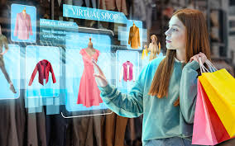

Introduction
Online shopping, also known as e-commerce, has transformed the way consumers purchase goods and services.
With the proliferation of internet access, smartphones, and digital payment systems, buying products online has become increasingly convenient, fast, and accessible to a growing global audience.

Slide 3
Market Trends
The worldwide e‑commerce market is projected to reach around US $6.86 trillion in 2025.
E‑commerce’s share of total retail is steadily increasing: estimated at ~20–21% of all retail purchases in 2025, rising toward ~22–23% by around 2028
India’s e‑commerce market size is estimated at around US $151 billion (≈ Rs 13,04,703 crore) in 2025
Chart represent future trends:

Slide 4
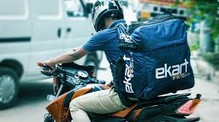
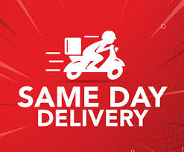
Logistics & Fulfilment
As online shopping volumes increase, the logistics and fulfilment side is becoming a critical differentiator for retailers and e‑commerce brands
Key segments of logistics for e‑commerce: warehousing & inventory management → order processing & picking/packing → last‑mile delivery → reverse logistics/returns
Consumer expectations of rapid delivery (next‑day, same‑day, even hours) are driving logistics redesign

Slide 5
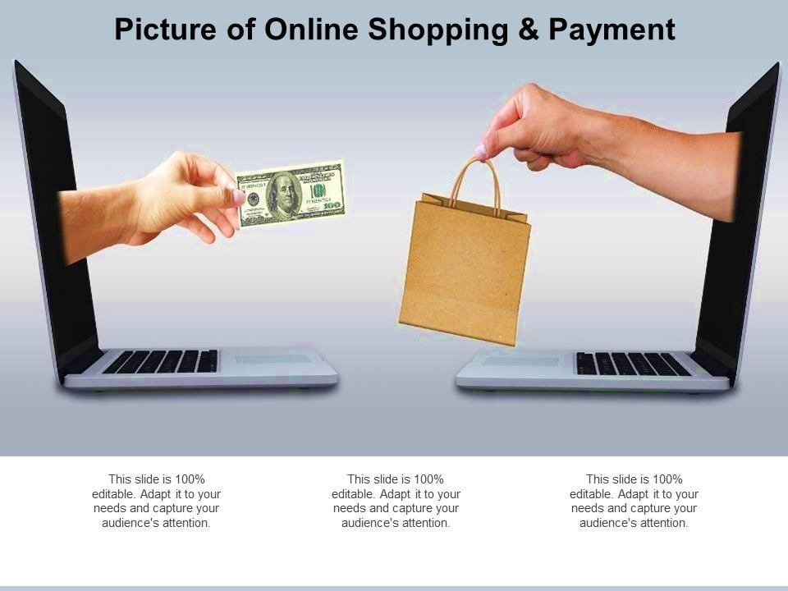
Benefits of online shopping
Global Access: Consumers can buy products from anywhere in the world. Shoppers have access to multiple brands and models in one place.
24/7 Availability: Online stores are open all day, every day, allowing consumers to shop anytime. Apps and mobile-friendly websites make shopping from anywhere easier.
Informed Decisions: User reviews and ratings help buyers assess product quality.

Slide 6
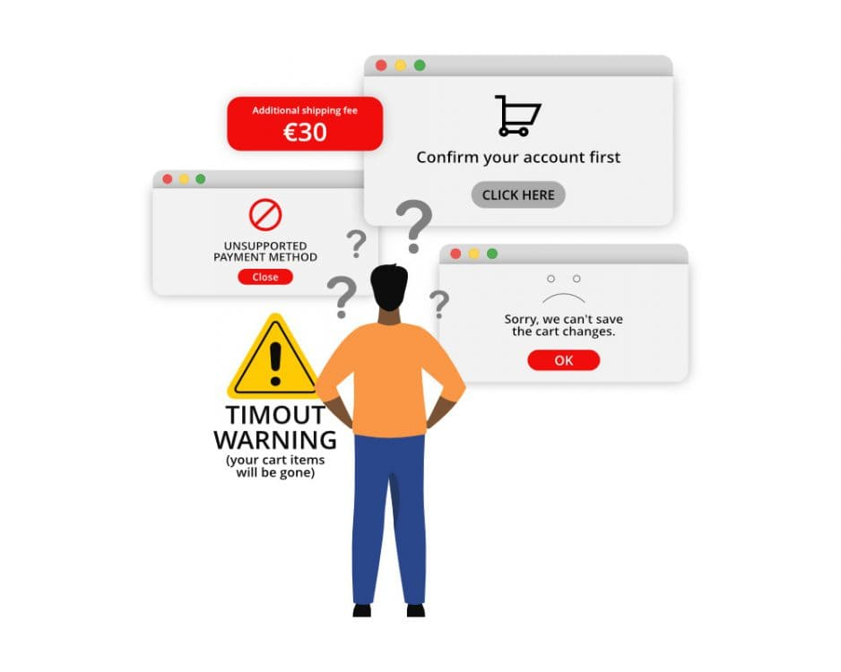
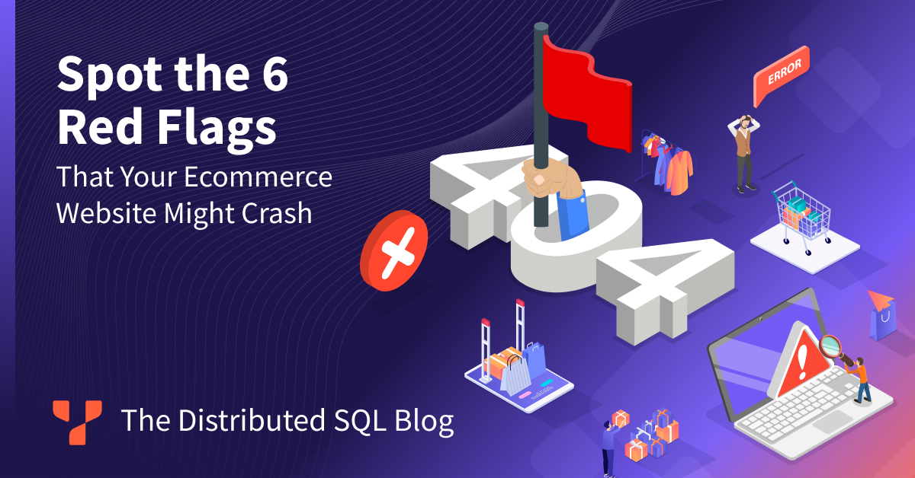
Challenges of online shopping
Product Quality Uncertainty: Customers cannot touch, feel, or try products before purchase. Particularly relevant for clothing, shoes, and accessories.
Data Breaches: Personal and financial information can be vulnerable to cyberattacks. Risk of fake e-commerce sites or scams tricking buyers.
Connectivity Issues: Poor internet access can disrupt shopping experience. App crashes, website downtime, or payment failures can frustrate buyers

Slide 7
Strategies
AI & Machine Learning: Use algorithms to recommend products based on browsing and purchase history. segment users by behavior to deliver highly relevant offers.
Micro-Fulfilment Centers: Smaller warehouses close to key urban areas for faster delivery. Use local couriers, lockers, drones, or on-demand delivery services
Green Logistics: Electric vehicles, optimized routes, and carbon-neutral delivery. Reduce plastic, use recyclable materials.

Slide 8
Conclusion
Online shopping has transformed the retail landscape, reshaping how consumers discover, evaluate, and purchase products.
Over the past decade, trends such as mobile commerce, social commerce, personalized recommendations, and fast delivery have become central to the e-commerce experience.
These trends are driven by consumer demand for convenience, variety, competitive pricing, and seamless digital experiences.

Slide 9
Thank You! 💡

